Slide 1
Revision Midterm

Slide 2


Slide 3
Number Systems

Slide 4
Revision: Number System
Here are 3 unsigned binary number:
add together the two smaller numbers
multiply the result of (a) with the largest numbers
Convert (4021.2)₅to its equivalent decimal
Convert (634)₈ to binary using partition method
Convert (9 B 2.1A) 16 to its decimal equivalent.
Convert 0.1289062 decimal number to its hex equivalent
G. Convert 0.640625 decimal number to its octal equivalent.
H. Convert (250)7 to base 3
I. Convert 287 to BCD
1110101 | 1011110 | 101001

Slide 5
Solution
(1110101)2=( 117)10
(1011110)2=(94)10
(101001)2=(41)10
So smaller 2 numbers are: 1011110 and 101001. Their summation is (10000111)2
B. Product is (10000111)2 and (1110101)2 is 11110110110011
C. Convert (4021.2)5 to its equivalent decimal
(4021.2)5= 4 x 53+ 0 x 52+ 2 x 51+ 1 x 50+ 2 x 5-1
= (511.4)10
D. (ii) Convert (634)8 to binary using partition method
6 3 4
110 011 100
Ans = 110 011 100
E. Convert (9 B 2 .1A) 16 to its decimal equivalent.
=(2482.1016)10
F Convert (0.1289062)10 to its hex equivalent
0.1289062 x 16 = 2.0625 0.0625 x 16 = 1.0
Ans. = 0.21
(250)7=(133)10=(11221)3
0010 1000 0111

Slide 6
Revision: Number System
223₇ + 561₇
AB78₁₆ + DF8C₁₆
101011₂ − 111₂
CAA8₁₆ − B9D₁₆
_{(234)9*(25)9}

Slide 7
Solution
A. (1114)7
B. (18B04)16
C. (100100)2
D. (BF0B)16
E. (6072)9

Slide 8
Number system
State the range of 9 bit 1’s complement number system
State the range of 9 bit 2’s complement number system
Represent +75 & -60 using 8 bit 1’s complement system
Represent +75 & -60 using 8 bit 2’s complement system
Subtract -60 from -75 using 1’s complement system. Is there overflow?
Subtract -60 from -75 using 2’s complement system. Is there overflow?
Add -60 to -75 using 1’s complement system. Is there overflow?
Add -60 to -75 using 2’s complement system. Is there overflow?

Slide 9
Solution
+255 to -255
+255 to -256
(75)10= 01001011; (-60)10= 11000011
(75)10= 01001011; (-60)10= 11000100
(11110000)1s
(11110001)2s
G. (01111000)1s; Overflow as 2 negative gives positive
H. (01111001)2s ; Overflow as 2 negative gives positive

Slide 10
Boolean Algebra

Slide 11
1.Represent the circuit of full adder with NAND gates
2. (A’+B)(B’+C)+AB’
a)Write the equation in simplified SOP format b) Write the equation in canonical SOP format
3. D(A’+B)+B’D a) Write the equation in simplified SOP format b) Write the equation in canonical SOP format

Slide 12


Slide 13
Solution
2 a) B’+C b)∑m(0,1,3,4,5,7)
3a) D
b) ∑m(1,3,5,7,9,11,13,15)

Slide 14
C(i) Convert to canonical SOP and then to POS format
F(A,B,C,D)=(((A’+B’+C)D) xor (AB)’)+ C’D’
(ii)Draw circuit of F

Slide 15
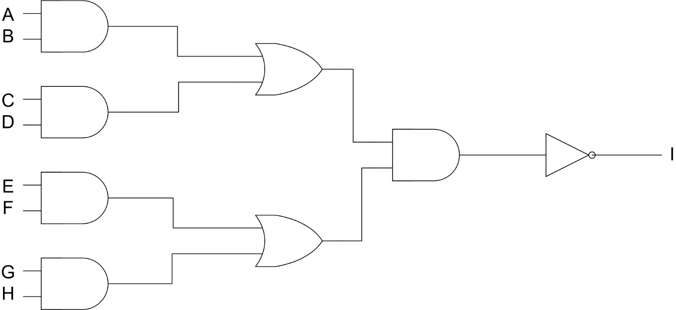
Draw the equivalent circuit using only NAND gates of the following circuit

Slide 16
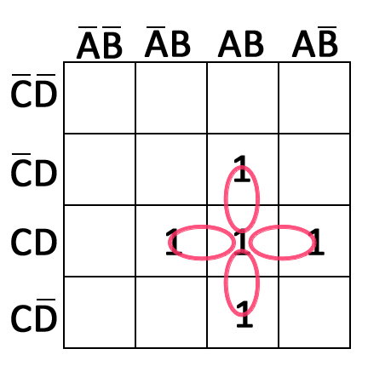
KMAP

Slide 17
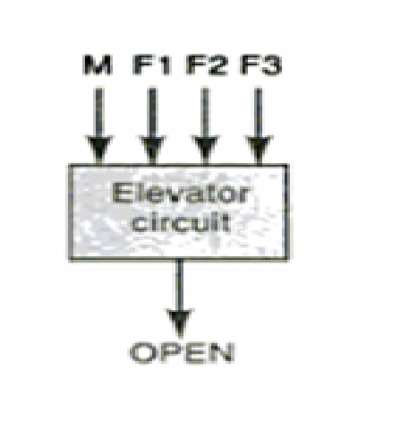
Kmap
s.
Design a logical circuit that controls opening of an elevator door in a 3 storied building. The circuit has 4 input, F1,F2,F3 and M. F1,F2 and F3 for the 3 floors and movement of lift is M. M=0 means elevator has stopped and M=1 means elevator is moving. F1,F2 and F3 are usually LOW and they go HIGH when the lift is aligned with respective floor. For Example if elevator is lined up with the second floor, F2=1,F1=0 ,F3=0 and M=1. At a time Lift cannot be aligned to 2 floors. So treat such condition where 2 or more floors are HIGH as don’t care. The circuit output is usually LOW and is only HIGH when the elevator door is open.
a)Using K-map write the Boolean algebraic representation in simplified format of the function for opening of lift door.
b) Draw the circuit for the expression using NAND gate

Slide 18
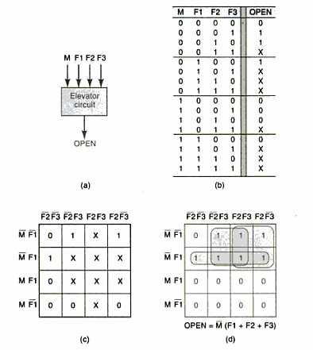
Solution

Slide 19
KMAP
Design a burglar system comprising of Door light and Burglar Alarm.
The circuit of door light will turn it on if its dark outside and its beyond 6 pm. Also there is someone on the door weighing more or equal to 15 kg and puts the key in the key hole within 10 minute minutes of arrival. The burglar alarm rings if there is someone more or equal to 15 kg is on the door step and has not put the key in the key-hole within 10 minutes of arrival. Consider that it is impossible to be dark before 6 pm and someone less than 15 kg cannot have house key to put inside key hole.

Slide 20
Solution
Considering
D:1-> dark
A:1-> 6pm or more
S:1-> someone more than or equal to 15kg is on the door step
K:1-> key is not placed in keyhole within 10 minutes of arrival
Door light on, DL(D,A,S,K)=DS
Burglar alarm rings, BAR(D,A,S,K)=SK

Slide 21
Review
Problem 2: A committee of three persons makes decisions by voting. To pass, a proposal must get YES votes from all three committee members or from the chairperson and one other member. The idea is that the chairperson by him or herself cannot approve a proposal, but that no proposal that doesn’t have the chairperson’s agreement can be approved.
To actually vote YES, each member presses a button in the table in front of them, which sends a signal to a controller that makes a display light up if the votes permitted the proposal to pass. The wires from the buttons to the controller are labeled with the abbreviations C, M0, M1 and M2. Considering electrical signals to correspond to a logical value of True, devise a logical function Z which will return the value True when a proposal has received adequate votes to pass, and sketch the corresponding digital circuit which makes use of NAND gates only.

Slide 22
Solution
Z=cp1p3’+cp2p3’+cp2p1+p1p2p3

Slide 23
Quine McCluskey
Simplify using Quine McCluskey
F(w,x,y,z)=∑m(1,2,3,5,9,12,14,15)

Slide 24
Solution
F(w,x,y,z)=A’C’D+A’B’C+ABD’+ABC+B’C’D+A’B’D

Slide 25
MSI

Slide 26
Adder & Magnitude Comparator
BCD to Excess 3 using Kmap
BCD to Excess 3 using adder
Derive the sum and carry equation of a 3 bit full adder
Design a 3 bit parallel adder-subtractor
Design a 16 people voting system where 0 means ‘No’ and 1 means ‘Yes’
Write down the equation equal, less and more for 7 bit Magnitude Comparator

Slide 27
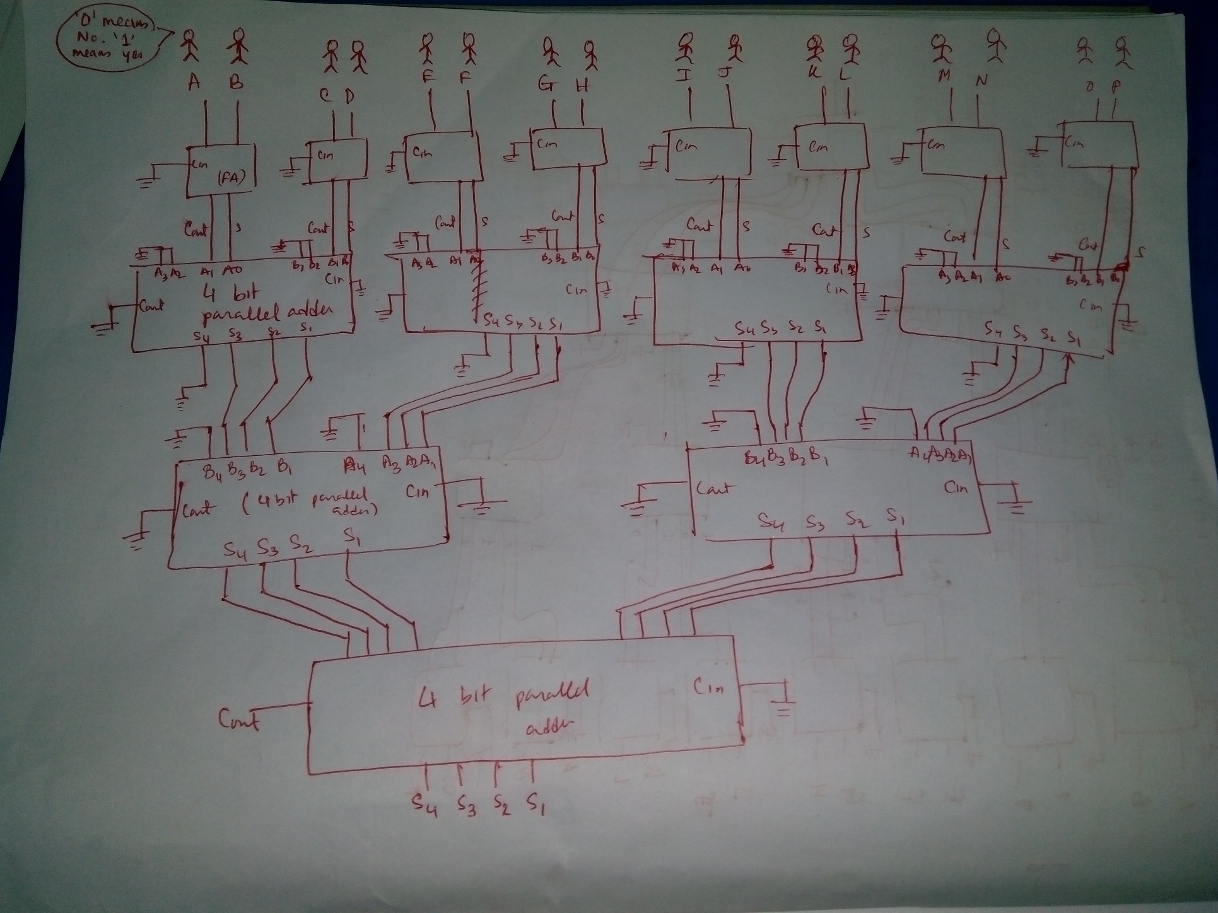
Solution
5)

Slide 28


